Slide 1
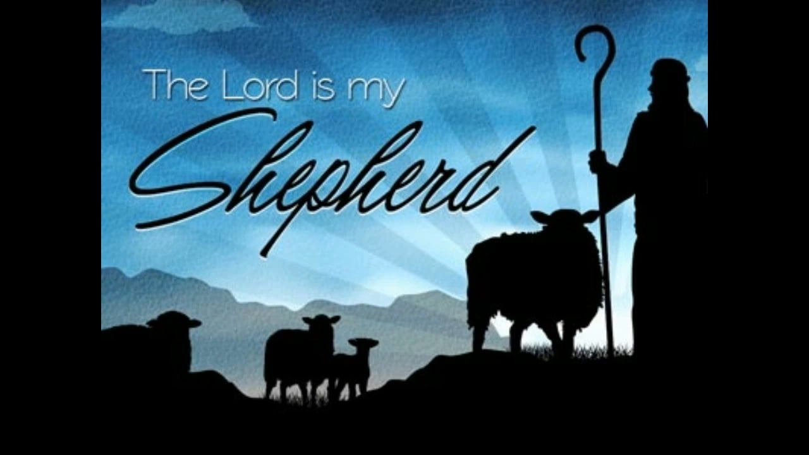
The 23rd Psalm Psalms of Guidance May 22, 2022

Slide 2
Psalms 23
1 The LORD is my shepherd; FAITH I shall not want. ASSURANCE
2 He maketh me to lie down in green pastures: CONTENTMENT he leadeth me beside the still waters. PEACE
3 He restoreth my soul: LIFE he leadeth me in the paths of righteousness for his name’s sake. LEADERSHIP

Slide 3
Psalms 23
4 Yea, though I walk through the valley of the shadow of death, CONFIDENCE I will fear no evil: COURAGE for thou art with me; COMPANIONSHIP thy rod and thy staff they comfort me. COMFORT
5 Thou preparest a table before me in the presence of mine enemies: PROVIDENCE thou anointest my head with oil; FAVOR my cup runneth over. JOY
6 Surely goodness and mercy shall follow me all the days of my life: MERCY and I will dwell in the house of the LORD for ever. IMMORTALITY

Slide 4
Joy – “My cup runneth over”
There is no more room for blessings. He is overjoyed as a result.
Psalms 36:8, “They shall be abundantly satisfied with the fatness of thy house; and thou wilt make them drink of the river of thy pleasures.”
Christians rejoice “in Christ.”
The eunuch went on his way rejoicing. Acts 8:39
The jailer’s household rejoiced. Acts 16:34
All Christians should rejoice. 1 Peter 4:12-14; Matthew 5:11-12; Philippians 3:1; 4:4
No one on earth has more right to rejoice than the people of God.
Notes:
Acts 8:38-39 – “³⁸ And he commanded the chariot to stop, and they both went down into the water, Philip and the eunuch, and he baptized him. ³⁹ And when they came up out of the water, the Spirit of the Lord carried Philip away, and the eunuch saw him no more, and went on his way rejoicing.”
Acts 16:32-34 – “³² And they spoke the word of the Lord to him and to all who were in his house. ³³ And he took them the same hour of the night and washed their wounds; and he was baptized at once, he and all his family. ³⁴ Then he brought them up into his house and set food before them. And he rejoiced along with his entire household that he had believed in God.”
I Peter 4:12-14 – “¹² Beloved, do not be surprised at the fiery trial when it comes upon you to test you, as though something strange were happening to you. ¹³ But rejoice insofar as you share Christ's sufferings, that you may also rejoice and be glad when his glory is revealed. ¹⁴ If you are insulted for the name of Christ, you are blessed, because the Spirit of glory and of God rests upon you.”
Matthew 5:11-12 – “¹¹ ‘Blessed are you when others revile you and persecute you and utter all kinds of evil against you falsely on my account. ¹² Rejoice and be glad, for your reward is great in heaven, for so they persecuted the prophets who were before you.’”
Philippians 3:1 – “Finally, my brothers, rejoice in the Lord. To write the same things to you is no trouble to me and is safe for you.”
Philippians 4:4 – “Rejoice in the Lord always; again I will say, Rejoice.”

Slide 5
Mercy – “Surely goodness and mercy shall follow me all the days of my life”
God blesses His people with the blessings of His goodness.
Psalms 31:19, “Oh how great is thy goodness, which thou hast laid up for them that fear thee”
Mercy … Psalms 40:11, “Withhold not thou thy tender mercies from me, O Jehovah; let thy lovingkindness and thy truth continually preserve me.”
“Mercy” used 116 times in the ASV. cf. Ephesians 2:4
God’s goodness is reserved for those who continue in His goodness. Romans 11:22
The prodigal understood that the goodness of his father’s house was reserved for those who lived there. cf. Luke 15:17
The blessings of salvation are reserved for those who continue to walk therein. 1 Corinthians 15:1-3; Colossians 1:21-23
Notes:
Ephesians 2:4 – “But God, being rich in mercy, because of the great love with which he loved us …”
Romans 11:22 – “Note then the kindness and the severity of God: severity toward those who have fallen, but God's kindness to you provided you continue in his kindness. Otherwise you too will be cut off.”
Luke 15:17 – “’But when he came to himself, he said, “How many of my father's hired servants have more than enough bread, but I perish here with hunger!”’”
I Corinthians 15:1-3 – “¹ Now I would remind you, brothers, of the gospel I preached to you, which you received in which you stand, ² and by which you are being saved, if you hold fast to the word I preached to you – unless you believed in vain. ³ For I delivered to you as of first importance what I also received: that Christ died for our sins in accordance with the Scriptures”
Colossians 1:21-23 – “²¹ And you, who once were alienated and hostile in mind doing evil deeds, ²² he has now reconciled in his body of flesh by his death in order to present you holy and blameless and above reproach before him, ²³ if indeed you continue in the faith stable and steadfast, not shifting from the hope of the gospel that you heard, which has been proclaimed in all creation under heaven and of which I, Paul, became a minister.”

Slide 6
Immortality – “And I will dwell in the house of the Lord for ever”
David understood that following the Lord not only provided blessings here, but that it provided for eternal life.
Abraham had this kind of faith. Hebrews 11:10-16
Job reflected it too. Job 14:14; 19:25-26
NOTE: Psalms 27:1-6
Godliness not only has the promise of the life that now is, but that which is to come. 1 Timothy 4:8; Mark 10:28-30
We will have a new body – 2 Corinthians 5:1; Philippians 3:20-21; 1 Corinthians 15:52-57
It is reserved in heaven for us. 1 Peter 4:5
The pursuit of enemies can last only for a little time (1 Peter 1:6; 5:10; 2 Corinthians 4:17), whereas the pursuit of goodness and mercy will last for ever.
Notes:
Hebrews 11:8-16 – “⁸ By faith Abraham obeyed when he was called to go out to a place that he was to receive as an inheritance. And he went out, not knowing where he was going. ⁹ By faith he went to live in the land of promise, as in a foreign land living in tents with Isaac and Jacob, heirs with him of the same promise. ¹⁰ For he was looking forward to the city that has foundations whose designer and builder is God. ¹¹ By faith Sarah herself received power to conceive, even when she was past the age, since she considered him faithful who had promised. ¹² Therefore from one man, and him as good as dead, were born descendants as many as the stars of heaven and as many as the innumerable grains of sand by the seashore. ¹³ These all died in faith. not having received the things promised, but having seen them and greeted them from afar, and having acknowledged that they were strangers and exiles on the earth. ¹⁴ For people who speak thus make it clear that they are seeking a homeland. ¹⁵ If they had been thinking of that land from which they had gone out they would have had opportunity to return. ¹⁶ But as it is, they desire a better country, that is, a heavenly one. Therefore God is not ashamed to be called their God, for he has prepared for them a city.”
Job 14:14 – “If a man dies, shall he live again? All the days of my service I would wait, till my renewal should come.”
Job 19:25-26 – “²⁵ For I know that my Redeemer lives, and at the last he will stand upon the earth. ²⁶ And after my skin has been thus destroyed, yet in my flesh I shall see God”
Psalms 27:1-6 – “¹ The Lord is my light and my salvation; whom shall I fear? The Lord is the stronghold of my life; of whom shall I be afraid? ² When evildoers assail me to eat up my flesh, my adversaries and foes, it is they who stumble and fall. ³ Though an army encamp against me, my heart shall not fear; though war arise against me, yet I will be confident. ⁴ One thing have I asked of the Lord, that will I seek after: that I may dwell in the house of the Lord all the days of my life, to gaze upon the beauty of the Lord and to inquire in his temple. ⁵ For he will hide me in his shelter in the day of trouble; he will conceal me under the cover of his tent; he will lift me high upon a rock. ⁶ And now my head shall be lifted up above my enemies all around me, and I will offer in his tent sacrifices with shouts of joy; I will sing and make melody to the Lord.”
I Timothy 4:8 – “… for while bodily training is of some value, godliness is of value in every way, as it holds promise for the present life and also for the life to come.”
Mark 10:28-30 – “²⁸ Peter began to say to him, ‘See we have left everything and followed you.’ ²⁹ Jesus said, ‘Truly, I say to you, there is no one who has left house or brothers or sisters or mother or father or children or lands, for my sake and for the gospel, ³⁰ who will not receive a hundredfold now in this time, houses and brothers and sisters and mothers and children and lands, with persecutions, and in the age to come eternal life.”
II Corinthians 5:1 – “For we know that if the tent, which is our earthly home, is destroyed, we have a building from God, a house not made with hands, eternal in the heavens.”
Philippians 3:20-21 – “²⁰ But our citizenship is in heaven, and from it we await a Savior, the Lord Jesus Christ, ²¹ who will transform our lowly body to be like his glorious body, by the power that enables him even to subject all things to himself.”
I Corinthians 15:51-58 – “⁵¹ Behold! I tell you a mystery. We shall not all sleep, but we shall all be changed, ⁵² in a moment, in the twinkling of an eye, at the last trumpet. For the trumpet will sound, and the dead will be raised imperishable, and we shall be changed. ⁵³ For this perishable body must put on the imperishable, and this mortal body must put on immortality. ⁵⁴ When the perishable puts on the imperishable, and the mortal puts on immortality, then shall come to pass the saying that is written: ‘Death is swallowed up in victory. ⁵⁵ ‘O death, where is your victory? O death, where is your sting?’ ⁵⁶ The sting of death is sin, and the power of sin is the law. ⁵⁷ But thanks be to God, who gives us the victory through our Lord Jesus Christ. ⁵⁸ Therefore, my beloved brothers, be steadfast, immovable, always abounding in the work of the Lord, knowing that in the Lord your labor is not in vain.”
I Peter 4:5 – ”… but they will give account to him who is ready to judge the living and the dead.”
I Peter 1:6 – “In this you rejoice, though now for a little while, if necessary, you have been grieved by various trials”
I Peter 5:10 – “And after you have suffered a little while, the God of all grace, who has called you to his eternal glory in Christ, will himself restore, confirm, strengthen, and establish you.”
II Corinthians 4:17 – “For this slight momentary affliction is preparing for us an eternal weight of glory beyond all comparison”

Slide 7
The 23rd Psalm …
Can you speak with the faith, conviction, confidence, and assurance of David?
Only if you let the Lord be your shepherd.
If you’ve not had Him as your Shepherd, why not start now?

Slide 8
The Character of the Person Who Dwells with the Lord
Psalm 15
Lesson 2: Psalms of Guidance
May 22, 2022

Slide 9
The Righteous person Psalm 15
Psalms 15:1, “Jehovah, who shall sojourn in thy tabernacle? Who shall dwell in thy holy hill?”
Character of integrity and holiness.
Question asked. 15:1
Only certain people will dwell in that place with Him (Psalms 61:4; Revelation 21:3; 7:15; John 14:2-3, 23).
Question answered. 15:2-5

Slide 10
The Righteous person Psalm 15
Psalms 15:2-5
2 He that walketh uprightly, and worketh righteousness, and speaketh truth in his heart;
3 He that slandereth not with his tongue, nor doeth evil to his friend, nor taketh up a reproach against his neighbor;
4 In whose eyes a reprobate is despised, but who honoreth them that fear Jehovah; He that sweareth to his own hurt, and changeth not;
5 He that putteth not out his money to interest, nor taketh reward against the innocent. He that doeth these things shall never be moved.
Positive
Positive

Slide 11
Stated Positively Psalms 15:2, 4
The Righteous person Psalm 15
Walks uprightly (2)
Anyone who claims to abide in the Lord “ought … to walk even as he walked” (1 John 2:6), without blemish (1 Peter 2:21-23; 1:19).
Walks in God’s truth. Psalms 26:3
Guided by God’s wisdom. Psalms 1:1-2; Proverbs 2:1-15; 4:5-9; Colossians 2:3

